Slide 1
Advanced Data Mining
Ensemble Learning

Slide 2
Slides based on
R. Schapire, Y. Freund (2012). Boosting: Foundations and Algorithms. MIT Press.
James, G., Witten, D., Hastie, T. and Tibshirani, R., 2008. The Elements of Statistical Learning. Springer. Chapter 16.
Other Resources:
https://www.cs.utexas.edu/~mooney/cs391L/slides/ensembles.ppt
https://project.dke.maastrichtuniversity.nl/datamining/2013-Slides/lecture-07.ppt
https://www.biostat.wisc.edu/~page/Ensembles.ppt
http://www.cs.ucsb.edu/~ambuj/Courses/165B/Lectures/ensemble%20learning.ppt
http://www.d.umn.edu/~rmaclin/cs8751/Notes/Ensemble.ppt
http://www.cs.cornell.edu/courses/cs4700/2008fa/PPT/CS4700-EL.ppt
http://sli.ics.uci.edu/Classes/2012F-273a?action=download&upname=10-ensembles.pdf
http://www.cs.man.ac.uk/~stapenr5/boosting.pdf

Slide 3
Basic idea of ensembles
Straightforward intuition:
In statistics and machine learning, ensemble methods use multiple learning algorithms to obtain better predictive performance than could be obtained from any of the constituent learning algorithms alone.
Usually, a machine learning ensemble consists of only a concrete finite set of alternative models, but typically allows for much more flexible structure to exist among those alternatives.

Slide 4
Rationale behind ensemble learning
The main motivation for this approach
The no free lunch theorem: there is no algorithm that is the most accurate (search or optimization for example) in all possible scenarios
Solution: generate a set of base-learners which when combined provide higher accuracy. There learners are different due to:
Algorithms
Internal parameters
Representations of the data (modalities)
Training sets
Different solutions to different subproblems

Slide 5
Rationale behind ensemble learning
Multiple diverse models are trained for the same problem and then their outputs are combined to come up with a final output.
The specific overfitting cause by each learning model can be averaged out
If models are diverse (uncorrelated errors) then even if the individual models are weak, the ensemble can be very accurate
Combining Technique
M₁
M₂
M₃
M_{n}

Slide 6
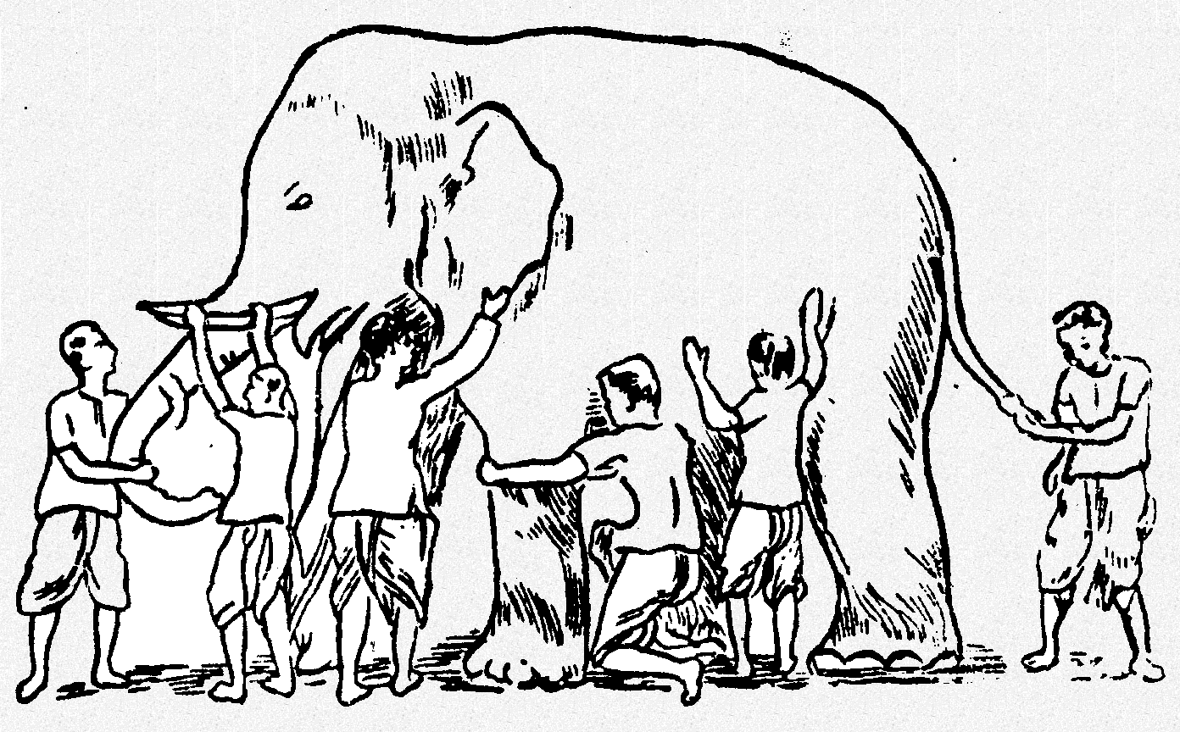
Rationale behind ensemble learning
Some unknown solution
Model 1
Model 6
Model 3
Model 5
Model 2
Model 4
The ensemble gives the global picture

Slide 7
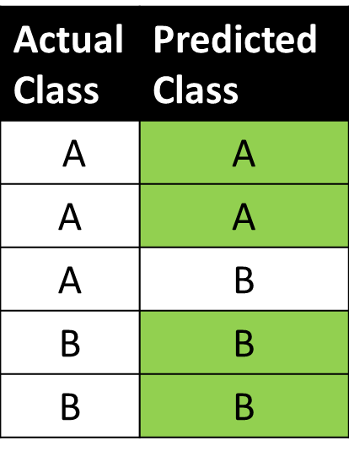
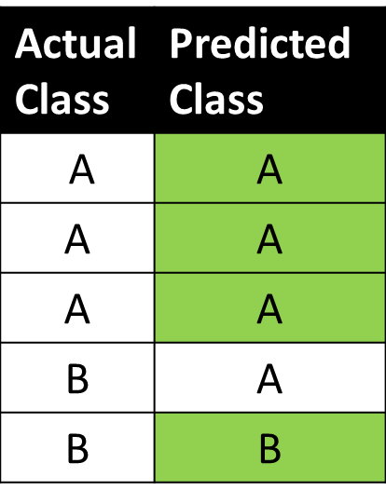
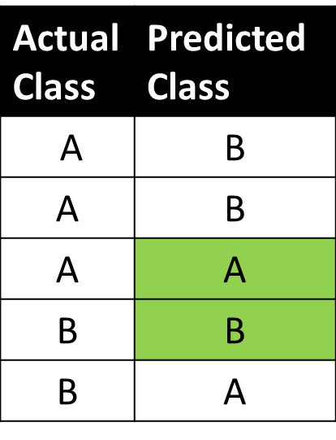
Ensemble learning: a simple example
Classifier 1 Classifier 2 Classifier 3
How would you combine these classifiers to improve accuracy?

Slide 8
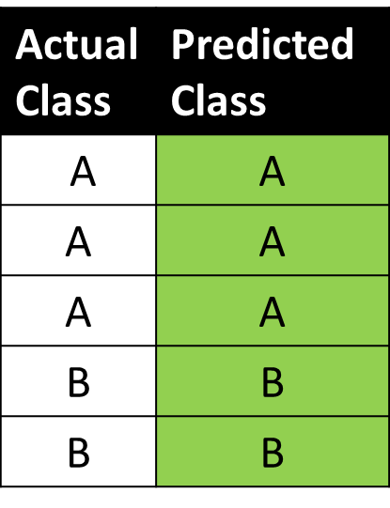
Ensemble learning: a simple example
Majority vote

Slide 9
Ensemble learning: a more realistic example
GAUSSIAN QUADRATIC
LINEAR BAYES
MULTILAYER NEURAL NETWORK
SIMPLE PERCEPTRON
Goal: combine all these methods to reach better classification accuracy
NEAREST NEIGHBOR
SUPPORT VECTOR MACHINE
How? gn

Slide 10

Ensemble learning: could bring you 1M$
https://en.wikipedia.org/wiki/Netflix_Prize

Slide 11
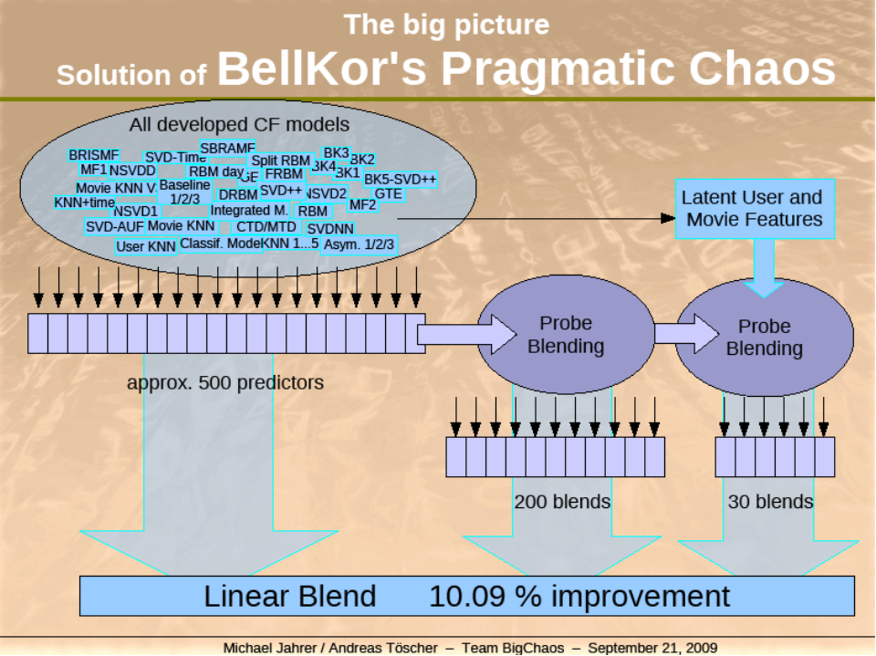
Ensemble learning: could bring you 1M$

Slide 12
Basic approaches
Simply averaging the predictions (or voting)
Bagging - train lots of classifiers on randomly different versions of the training data, then basically average the predictions
Boosting – train a series of classifiers – each one focussing more on the instances that the previous ones got wrong. Then use a weighted average of the predictions

Slide 13
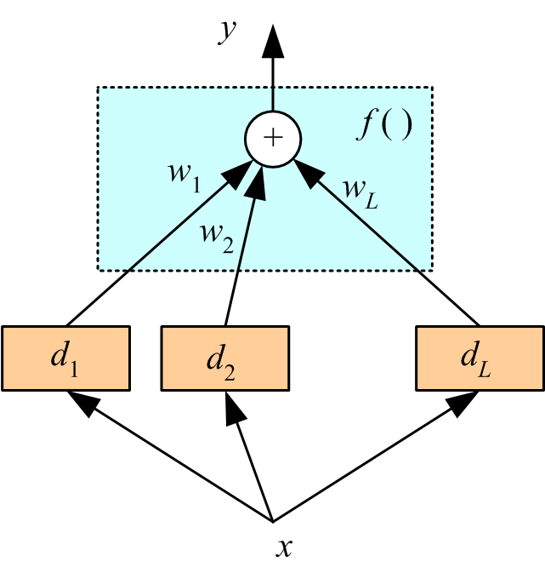
Simple ensembles (voting)
Pay attention of this structure, we will see similar things in the future
Simple committees (or voting)
Unweighted average (for numerical values)
Majority vote (for categorical values)
Weighted decisions
x is the input data
d_{i} is the decision of classifier i
w_{i} is the weight this classifier i has
w_{i} may need to be learned themselves
f() is a function that calculates output
f() can be for example the sign function
y is the weighted decision of the ensemble
Procedures like this are sometimes called
amplifying weak learners

Slide 14
Simple ensembles (voting)
Simple ensembles are nice because you can analyze them quickly
For example, let us assume that we have at our disposal n independent models, each with an accuracy of 60% on a two class problem
Question 1: If all n models predict the same class, what is the confidence that we have in the result? (i.e., what is the probability that all predictors are wrong?)

Slide 15
Simple ensembles (voting)
Simple ensembles are nice because you can analyze them quickly
For example, let us assume that we have at our disposal n independent models, each with an accuracy of 60% on a two class problem
Question 1: If all n models predict the same class, what is the confidence that we have in the result? (i.e., what is the probability that all predictors are wrong?)
Answer 1: 1 – 0.4^{n}, for example if n = 10 then the confidence is 99.4%

Slide 16
Simple ensembles (voting)
Simple ensembles are nice because you can analyze them quickly
For example, let us assume that we have at our disposal n independent models, each with an accuracy of 60% on a two class problem
Question 1: If all n models predict the same class, what is the confidence that we have in the result? (i.e., what is the probability that all predictors are wrong?)
Answer 1: 1 – 0.4^{n}, for example if n = 10 then the confidence is 99.4%
Question 2: What is our confidence in the result if a models say class 1 and b models say class 2? We have a total of n models.
Answer 2: P(majority vote is correct) = 1 – Binomial(n, min(a,b), 0.6)
What is Binomial here?

Slide 17
Simple ensembles (voting)
Simple ensembles are nice because you can analyze them quickly
For example, let us assume that we have at our disposal n independent models, each with an accuracy of 60% on a two class problem
Question 1: If all n models predict the same class, what is the confidence that we have in the result? (i.e., what is the probability that all predictors are wrong?)
Answer 1: 1 – 0.4^{n}, for example if n = 10 then the confidence is 99.4%
Question 2: What is our confidence in the result if a models say class 1 and b models say class 2? We have a total of n models.
Answer 2: P(majority vote is correct) = 1 – Binomial(n, min(a,b), 0.6)
What is Binomial here? The binomial distribution: the probability of getting a (or b) successes in n trials given the success probability in each trial p.

Slide 18
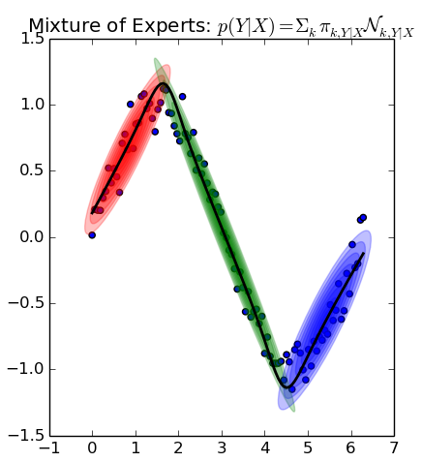
When does simple averaging work well?
Simply averaging the predictions works best when:
Your ensemble is full of fairly accurate classifiers
... but somehow they disagree a lot (i.e. When they’re wrong, they tend to be wrong about different instances)
In theory, we can reach high accuracy in this situation
Mixture of linear experts
3 Gaussian mixture models
3 linear regression models combined
How could we also model this?
(Use what we have seen from previous classes)

Slide 19
When does simple averaging work well?
Simply averaging the predictions works best when:
Your ensemble is full of fairly accurate classifiers
... but somehow they disagree a lot (i.e. When they’re wrong, they tend to be wrong about different instances)
In theory, we can reach high accuracy in this situation
Mixture of linear experts
3 Gaussian mixture models
3 linear regression models combined
How could we also model this?
Model Tree: from 0 to 2 do linear mode 1
from 2 to 4.5 do linear model 2 and from
4.5 to 6 do linear model 3

Slide 20
Bagging (Bootstrap aggregating)
Step 1: Learn many classifiers, each with its own data
Step 2: Combine them, usually average them
Step 3: Brag about the results (optional)
Very good against overfitting
We reduce the variance in the results (due to the averaging)
In practice this provides consistent improvements
Many times, the classifier is the same; what’s different is the input data and maybe the initial conditions of the algorithm (for example, when clustering we run k-means several times with different initial centroids)
This way, we reduce the variability in the result caused by initial starting conditions for the learning methods

Slide 21
Bagging
Bootstrap
Create a random subset of the data by sampling
Draw n’ of the n samples with replacement
Bagging
To train, repeat K times
Bootstrap the dataset
Train a classifier on this subset
To test, run each classifier
Each classifier votes on the output, take majority
For regression, take average
Clear advantages:
Complexity under control (we only work only a subset of the data)
Overfitting mostly avoided (again because it is hard to “over-learn” since we only see parts of the data at any given point)
A good example: random forests = bagging for decision trees

Slide 22
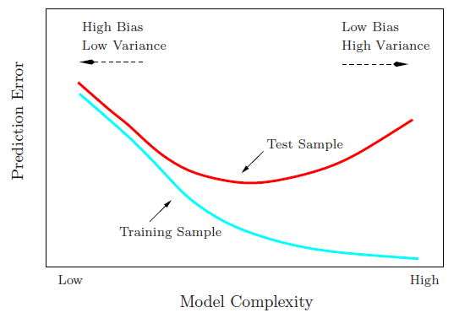
Bagging
The errors that we see in our models are due to two major factors:
Bias: error due to the model choice that we made (we think that the predictor is linear but actually the actual data follows a quadratic model)
Variance: error due to noise (randomness or variability) in the data
By using complex models we reduce bias (but potentially add variance)
By running many models and averaging we reduce the variance

Slide 23
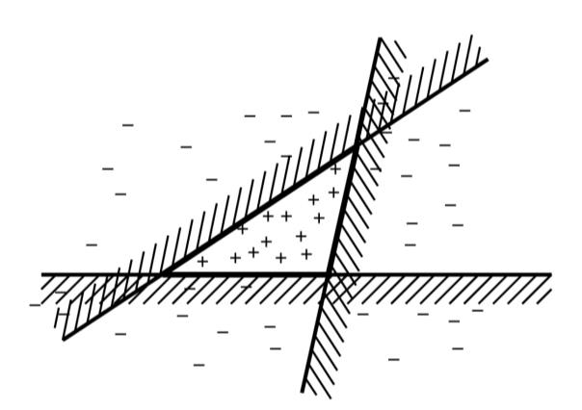
Boosting
Train the classifiers in a sequence (before they were completely independent!)
The new classifiers are going to focus exactly on the cases were the previous classifiers did badly
This way, each classifier is “weak” (it is not very general, it is just an expert in a very low number of cases) but the ensemble is “strong” (you have a large collection of very specialized experts that cover all cases)
Example: each separator is bad (if we
take it independently) but together they
separate exactly the space between +, -

Slide 24
Boosting
We adaptively weigh each data case
Data cases which are wrongly classified get high weight (the algorithm will focus on them in the next steps)
Each boosting round learns a new (simple) classifier on the weighed dataset
These classifiers are weighed to combine them into a single powerful classifier
Classifiers that obtain low training error rate have high weight
We stop by monitoring a hold out set (cross-validation)

Slide 25
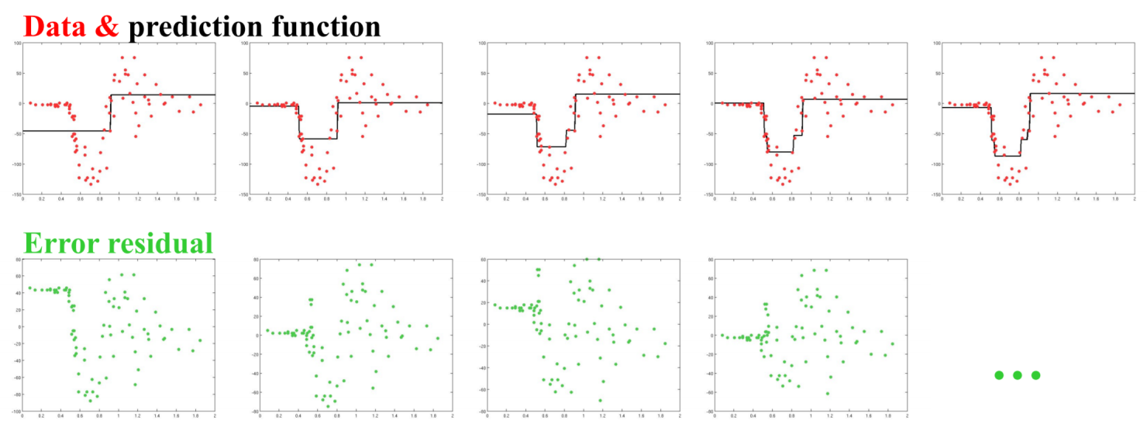
Gradient boosting
This is a boosting method for linear regression:
Learn a regression predictor
Compute the residual error
Learn a regression predictor (but only on the residual)

Slide 26
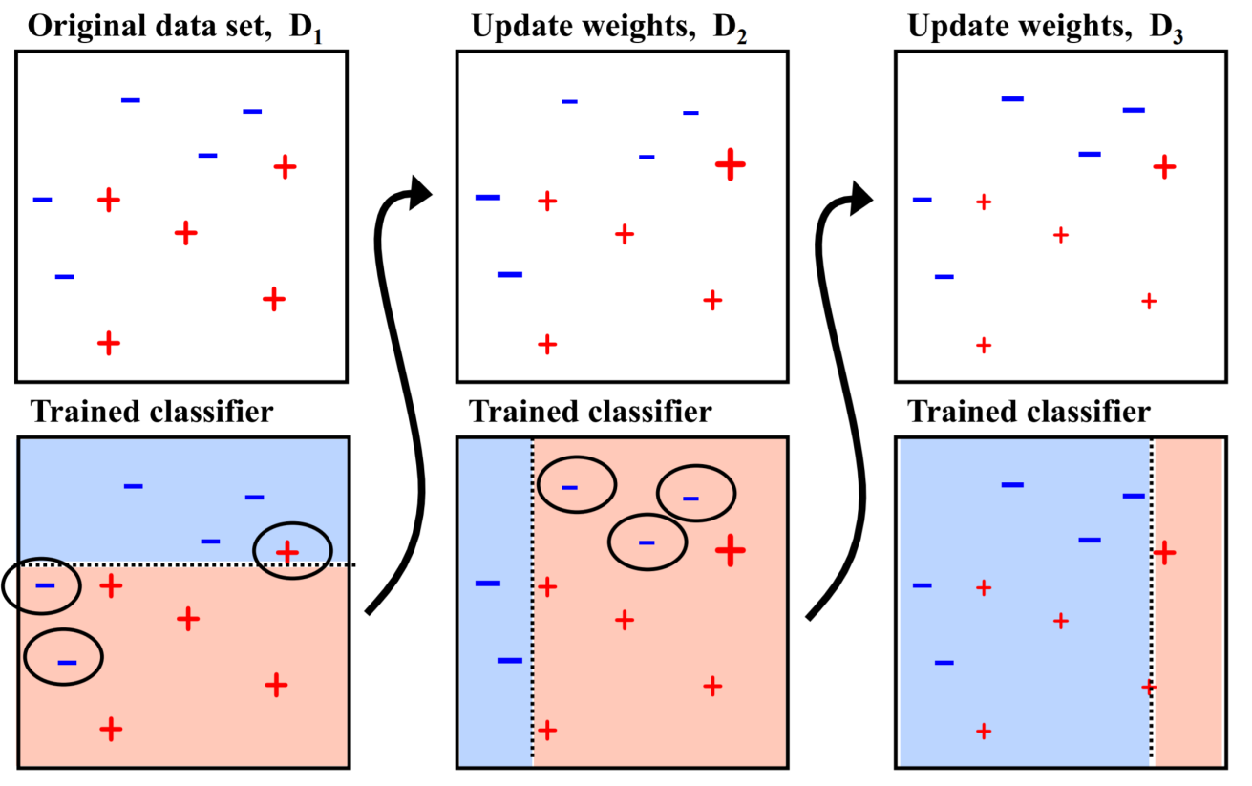
Classification boosting

Slide 27
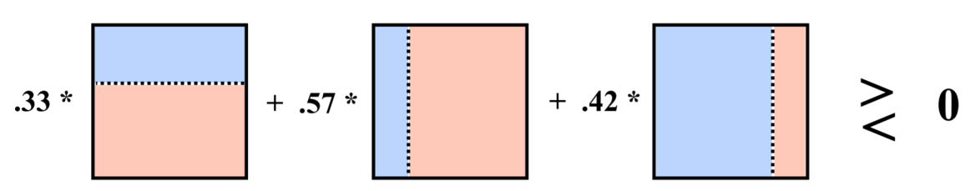
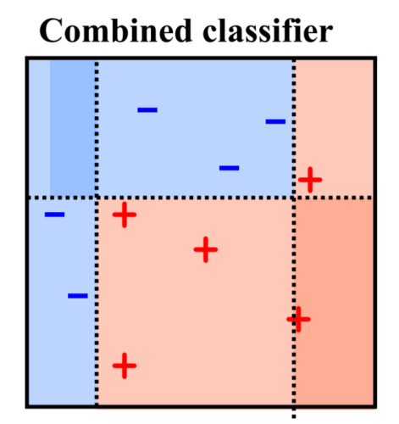
Classification boosting
Weight each classifier
The result:

Slide 28
Boosting for classification: AdaBoost
AdaBoost: adaptive boosting
Probably the most popular ensemble algorithm
The algorithm adapts the weights of the learners and of the training data
This is a heuristic, but there are many mathematical explanation why it works so well in practice

Slide 29
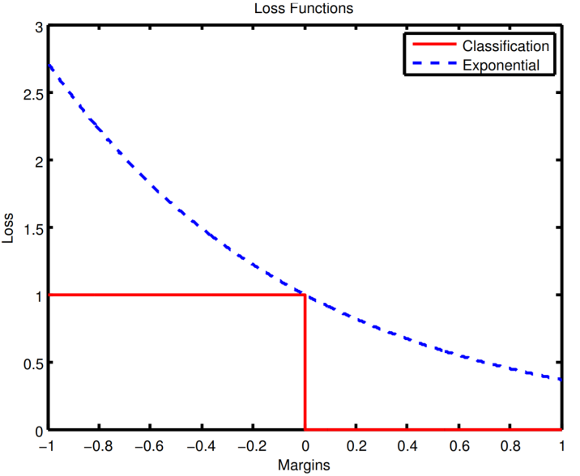
Boosting for classification: AdaBoost
AdaBoost has an exponential loss function
The red loss functions is the
ideal classification error measure:
If you are correct, 0 error
If you are wrong, 1 error
This all or nothing way of thinking is
is not useful in most situations
Why? Because I want to have a
measure of how wrong I am
Example: I ask you what’s 2+2 and
you give me two answers “5” and “tomato”. Both answers are wrong, but one is “more wrong” than the other
The blue loss function gives a measure of how wrong we are
e^{-x}

Slide 30
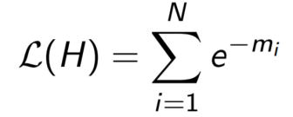
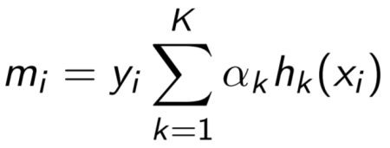
Boosting for classification: AdaBoost
We are given a training dataset with N samples and we have K learners
So, what’s the loss function of AdaBoost?
We sum up all the errors. The exponential is low when we are correct ad high when we are not.
x_{i} is the i^{th} data point
h_{k}(x_{i}) is the prediction that
learner k makes about point i
α_{K} is the weight that learner k
has in the overall prediction of data point i
the total sum is what the
ensemble “thinks” is the correct
prediction
y_{i} is the correct, known, class of data point i
The idea: When the true class (y_{i}) and the predicted class (the summation on K) match then their product (m_{i}) is positive, and with the negative sign in front, the loss function is low. Otherwise the loss function is high and the algorithm needs to improve in order to minimize it.

Slide 31
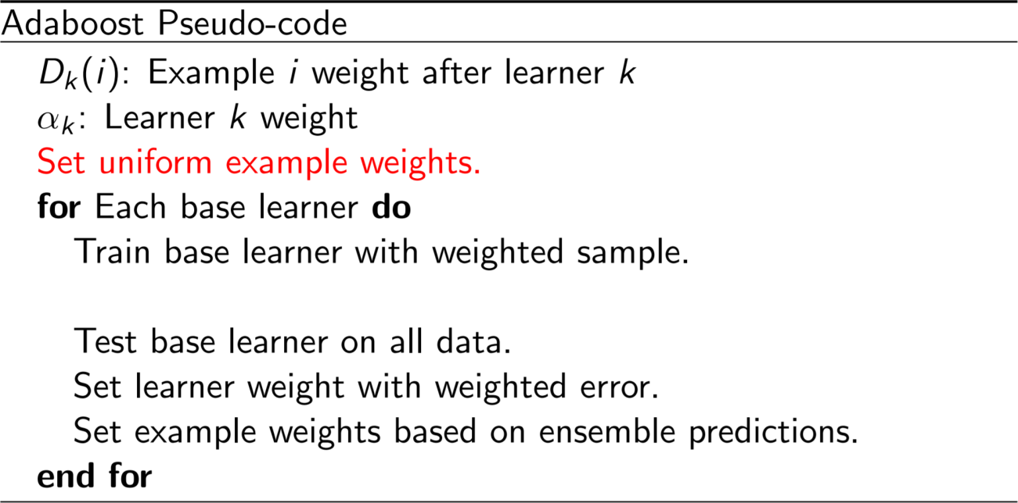
Boosting for classification: AdaBoost

Slide 32
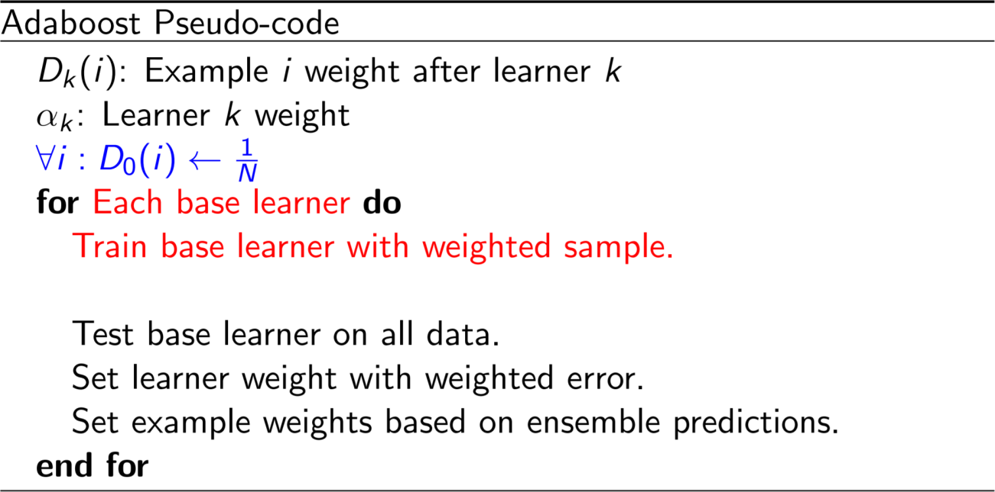
Boosting for classification: AdaBoost

Slide 33
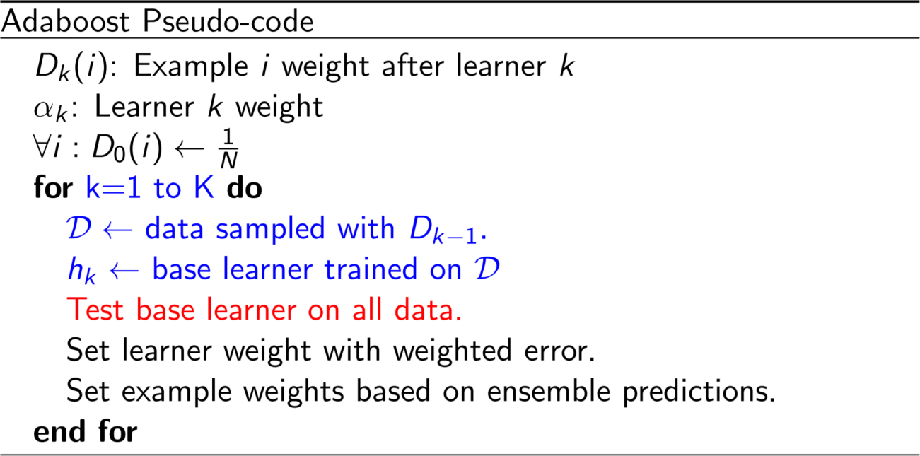
Boosting for classification: AdaBoost

Slide 34
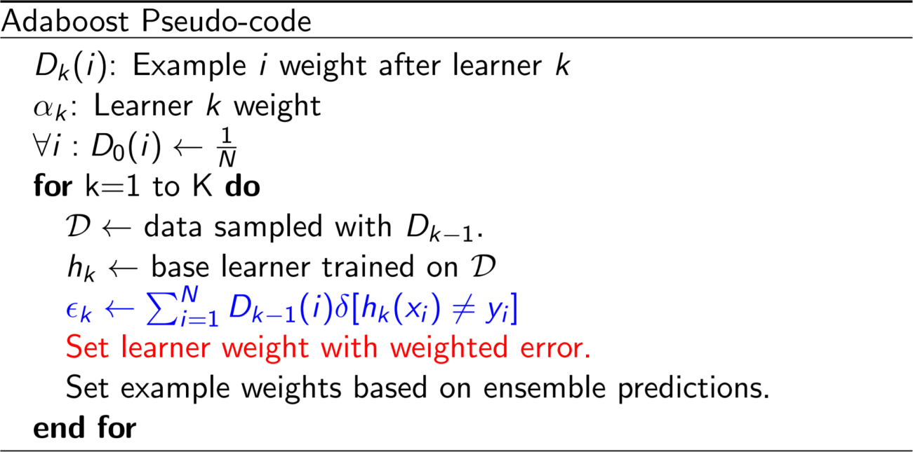
Boosting for classification: AdaBoost

Slide 35
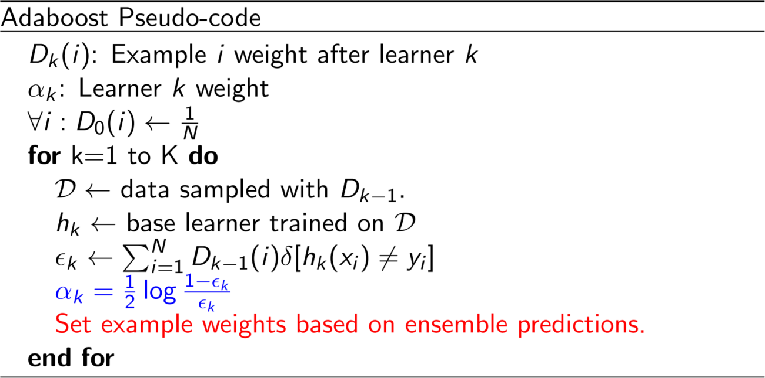
Boosting for classification: AdaBoost

Slide 36
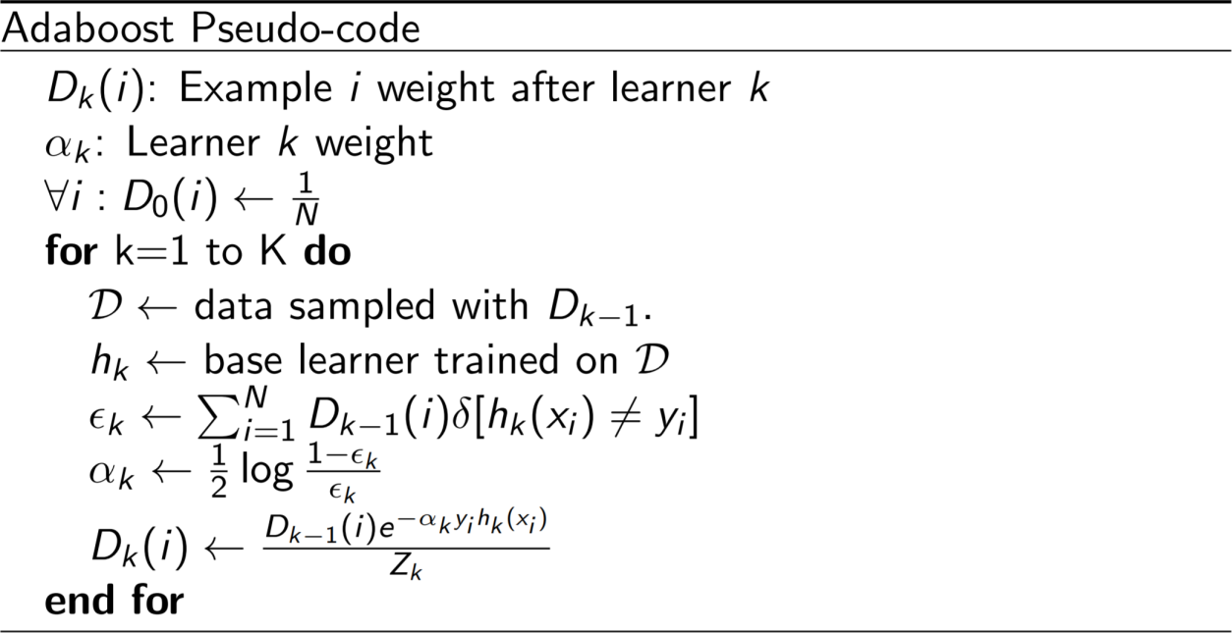
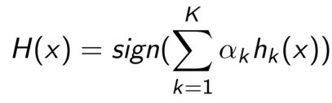
Boosting for classification: AdaBoost
Final decision rule:

Slide 37
AdaBoost: Variant Algorithm
Algorithm: AdaBoost (Boosting algorithm to create an ensemble of classifiers. Each one gives a weighted vote)
Input: D, a set of d class-labeled training tuples
k, the number of rounds (one classifier generated per round)
a classification learning scheme
Output: A composite model

Slide 38

AdaBoost: Variant Algorithm
Method:
1) Initialize the weight w_{j} of each tuple in D to 1/d
2) for i = 1 to k do:
3) D_{i} <- sample D with replacement according to tuple weights
4) use D_{i} to derive model M_{i}
5) compute error rate for M_{i}
if error(M_{i}) > 0.5
go to step 3)
endif
foreach tuple in D_{i} correctly classified do
multiply the weight of the tuple by error(M_{i}) / (1- error(M_{i}) )
normalize the weight of each tuple
endfor
err(X_{j}) is the misclassification error of tuple X_{j}
To normalize a weight: multiply it by the sum of the old weights divided by the sum of the new weights

Slide 39
AdaBoost: Variant Algorithm
Ensemble Classification of Tuple X:
1) Initialize the weight of each class to 0
2) for i = 1 to k do:
w_{i} =
c = M_{i} (X)
add w_{i} to weight for class c
6) endfor
7) return the class with the largest weight

